Slide 1
Blockchain Based Autonomous Selection of Electric Vehicle Charging Station
Group 14 Mitesh Kumar Singh Sweta Kumari Varun Agarwal

Slide 2
Overview..
Implementing a system to establish peer- peer connections between Electric vehicle (EV) and Electric vehicle (EV) charging stations - to find the most optimal charging station(EVCS).
Need a system where there is:
No trusted central entity (for e.g. authentication and billing) is needed
No subscription or prior business arrangement is required,
Transparent service negotiation/agreement that includes instant low-cost payment for charging can be achieved.
Full automation of the session is possible.

Slide 3
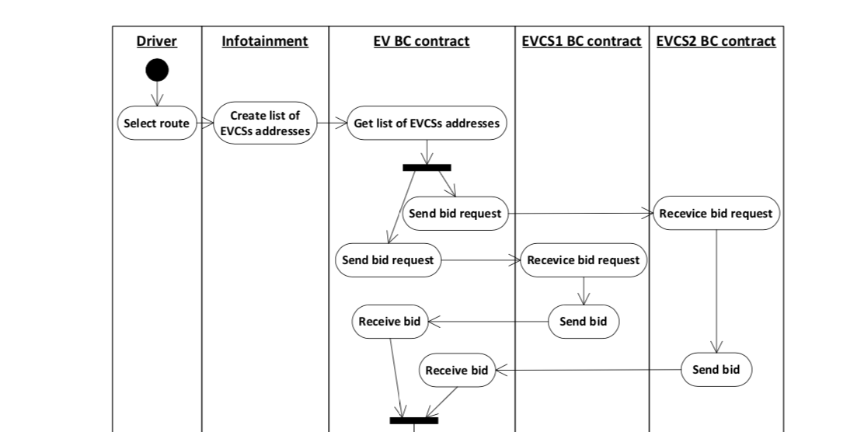
Sequence Diagram

Slide 4
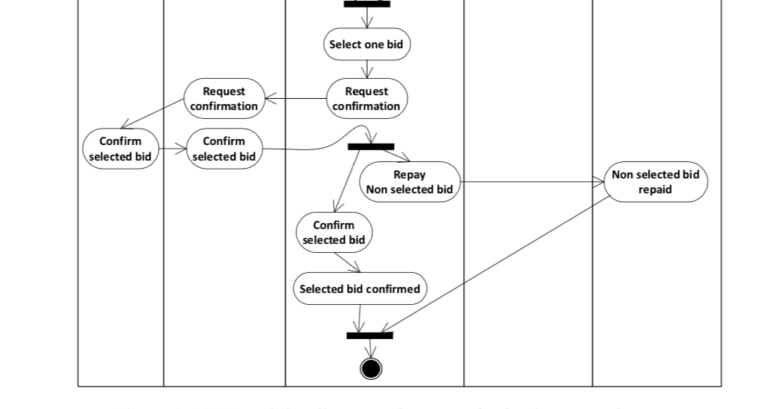
Send Token to Selected Bid

Slide 5
Progress
API to get the nearby charging stations - PlugShare
P2P payments on Blockchain - utilizing Ethereum Blockchain network
Mobile App to interact - UI

Slide 6
API to get the nearby charging stations - PlugShare
Plugshare is a service to look for electric vehicles charging station. It’s basically a database of charging stations.
Get Nearby Locations - GET https://api.plugshare.com/locations/nearby
Fetch Locations along route - POST https://api.plugshare.com/locations/polyline?minimal=1
Based on current location a car would find nearby charging stations within fixed range.

Slide 7
Finding the Optimal Charging Station
Each car is present with blockchain contract (EV BC contract) . It is responsible for Blockchain Communication .
The car infotainment system and EV BC contract communicate via Ethereum BC API.
The car infotainment system based on their location, it creates a list of the potential EV CS and passes their Ethereum addresses to EV BC contract. The later sends bid request to CS’s smart contracts (EVCS BC contract)
For the implementation of the proposed solution two smart contracts are required: EV BC contract for the vehicle and EVCS BC contract for the charging station.

Slide 8
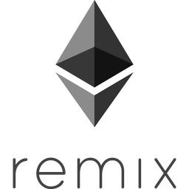
Working System
Ethereum : It’s a decentralized platform which provides a platform to build DApps (Decentralized Applications) by running smart contracts on it.
Solidity : It’s the programming language to write smart contracts for the Ethereum blockchain.
Remix : It’s a web browser based IDE that allows you to write Solidity smart contracts, then deploy and run the smart contract.
Notes:
The advantage of running Remix from your local/remote computer is that it can communicate with an Ethereum node client running on your local machine via the Ethereum JSON-RPC API. You can then execute your smart contracts in Remix while connected to your local/remote development blockchain, the Testnet blockchain, or the Mainnet blockchain.

Slide 9
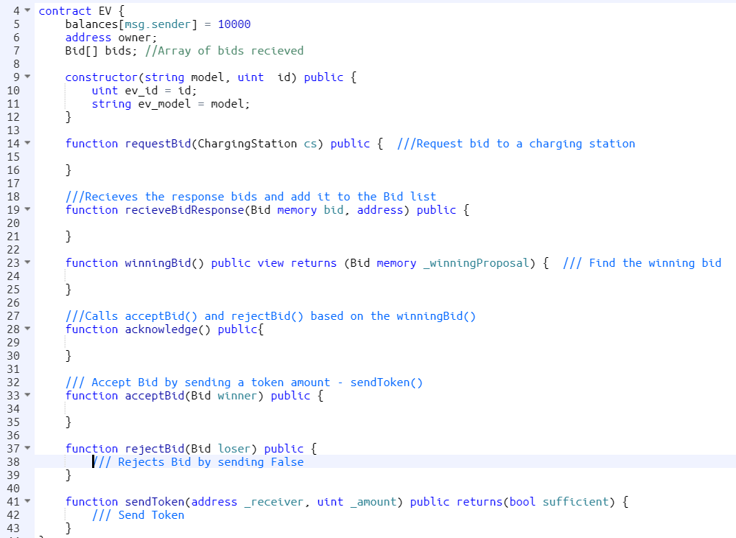
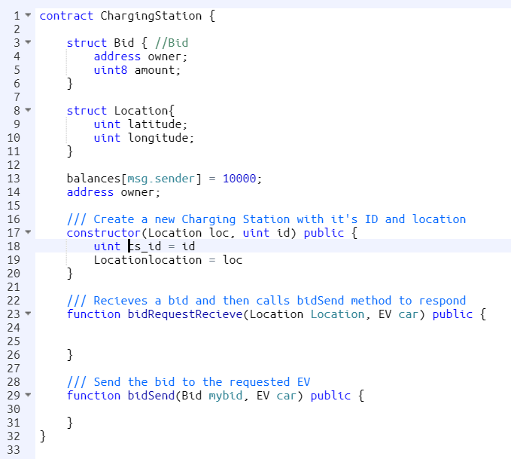
Contracts
Notes:
The advantage of running Remix from your local/remote computer is that it can communicate with an Ethereum node client running on your local machine via the Ethereum JSON-RPC API. You can then execute your smart contracts in Remix while connected to your local/remote development blockchain, the Testnet blockchain, or the Mainnet blockchain.

Slide 10
What we couldn’t do (still working on it)
We couldn’t integrate Plugshare in our blockchain environment. Instead, we made dummy charging stations and EVs to test our system.
Make bids more complex and real time-like.
UI
Scalable System

Slide 11
THANK YOU !

